Slide 1


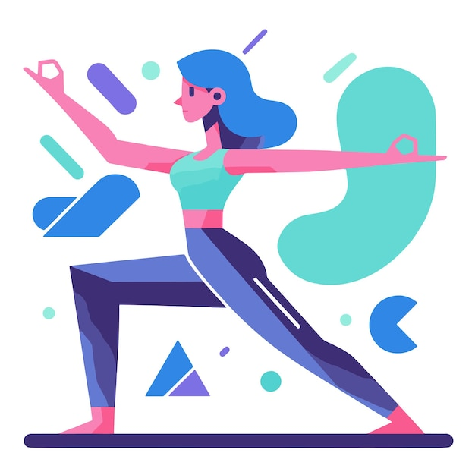

योगAI Align. Improve. Transform – with AI-Powered योग.
Powered by
Bhimtal Campus
Developed with ❤️by team Dash 2.0
Mayank Kumar
Shankar Singh
Sourav Chuphal
Anjali Padaliya
Manas Mehta

Slide 2
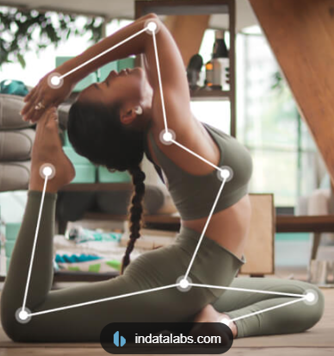
Powered by
Problem statement: The objective of this competition is to develop an AI/ML model that can accurately classify images based on the yoga posture depicted. The model should be capable of distinguishing between different yoga poses. Participants will preprocess the dataset, develop and evaluate a machine learning model, and ensure it performs well across different image conditions and variations. The goal is to enhance the accuracy of yoga posture classification, which can be useful for yoga practice apps, fitness tracking, and improving user experiences in yoga-related applications.
You wake up in the morning, feeling like doing yoga — also you’re trying, but you’re not even sure if you’re doing it right or wrong. So you open YouTube… try to copy a pose… but there’s no one to tell you: “Hey, your arm is raised 15° too high!”
The result? No improvement. No consistency. Just guesswork And that’s how YOG-AI was born. Complete guidance delivered right on WhatsApp. No app. No heavy setup.

Slide 3
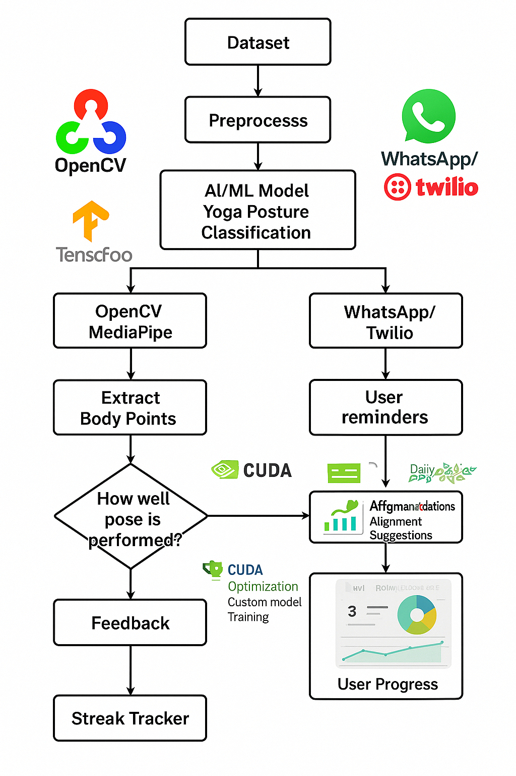
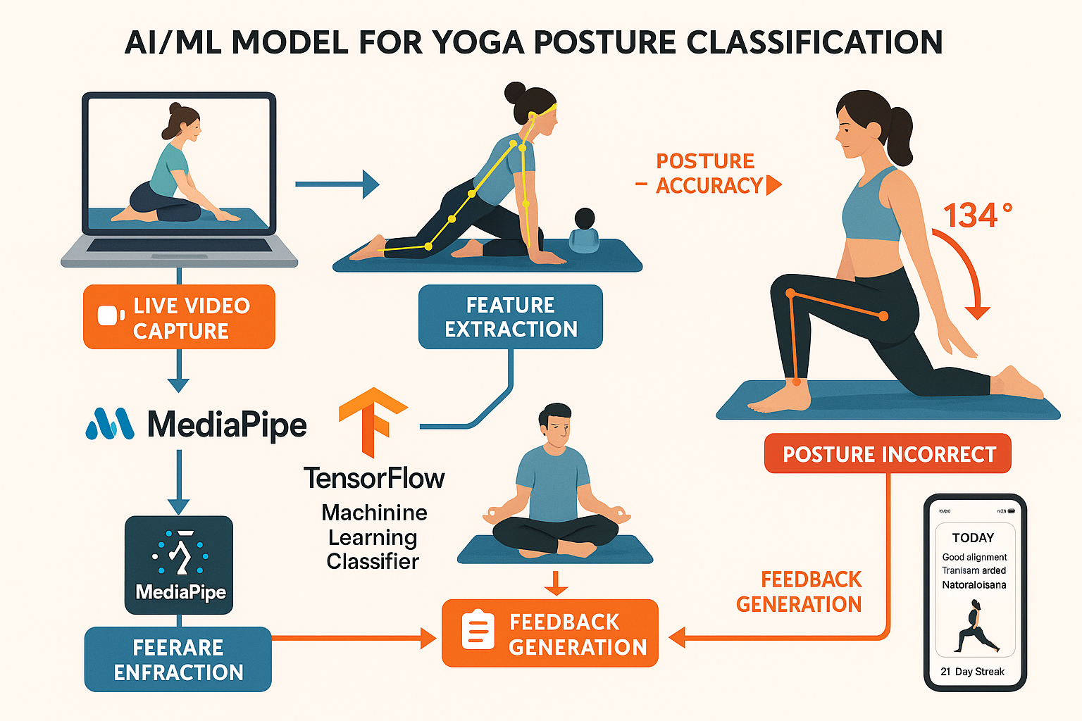

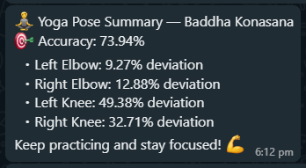


योगAI :Architecture Diagram
Powered by
ML Model + Real World Solution
Red Pipes for Bad postures
Green Pipes for good postures
Giving Real Time
AUDIO guide.

Slide 4
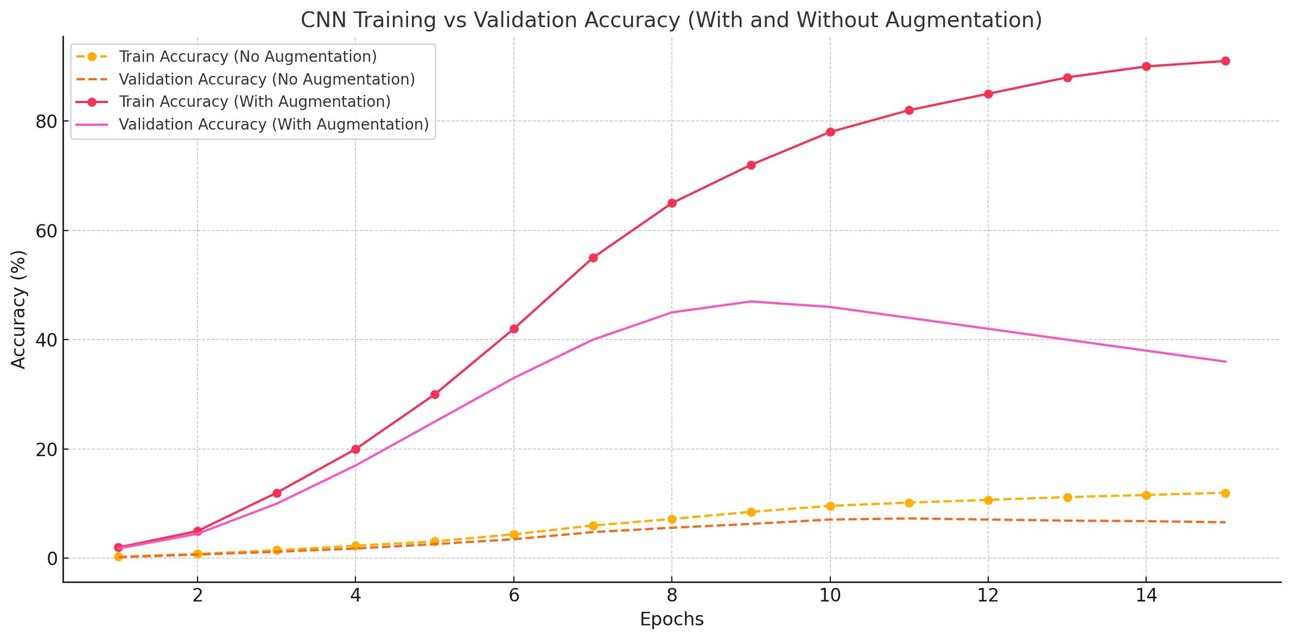
Powered by

Slide 5
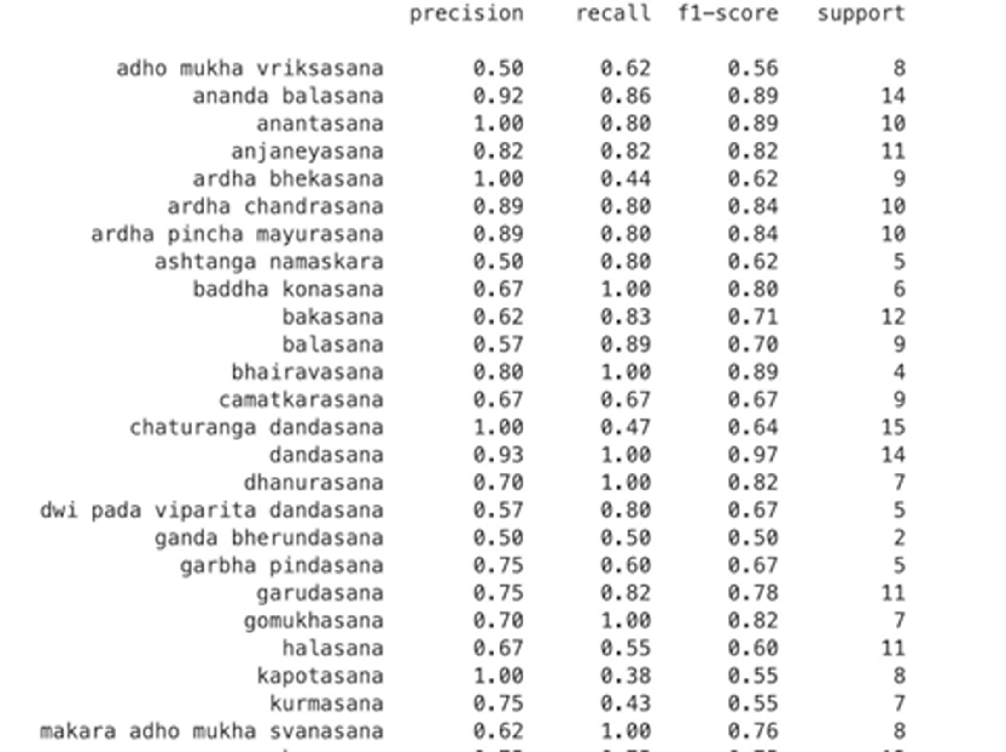
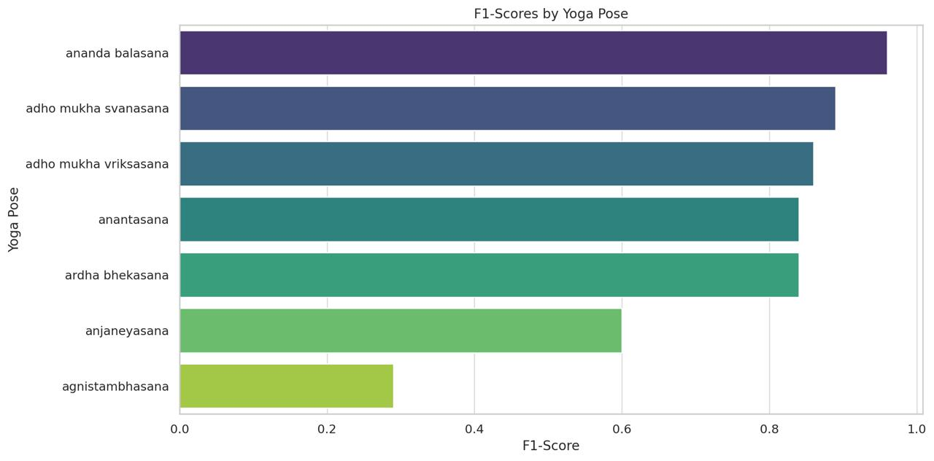
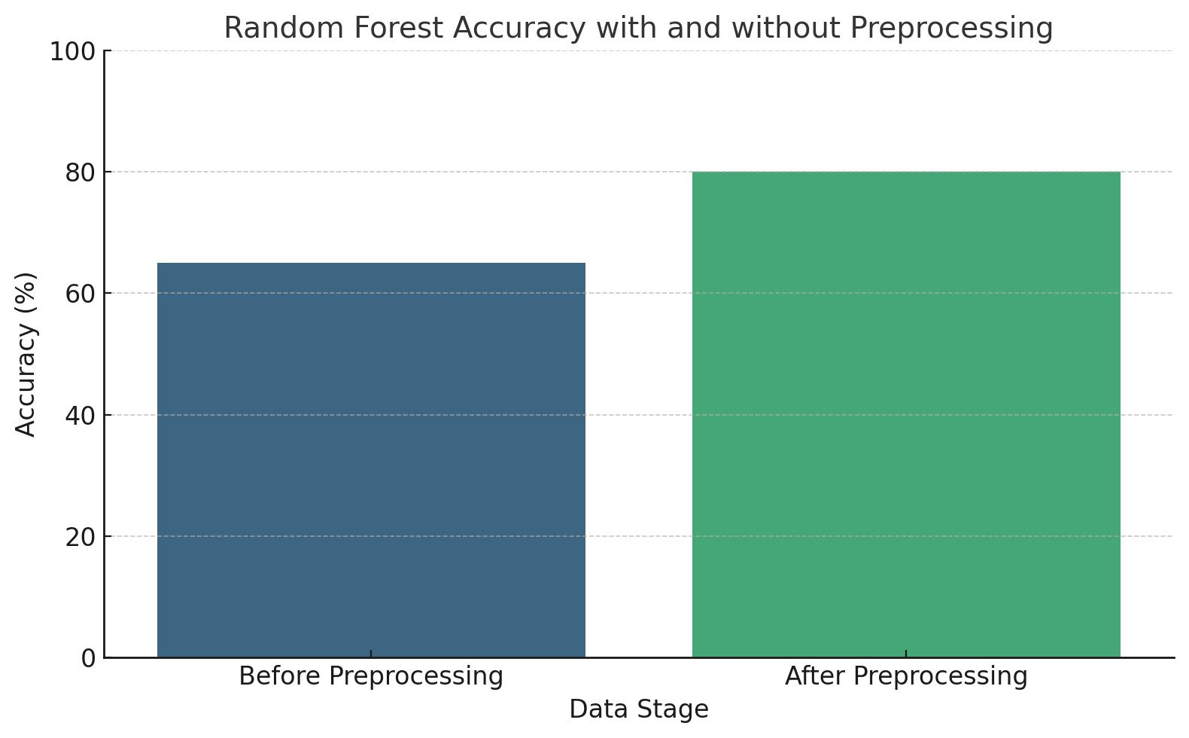
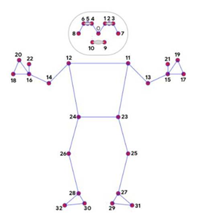
33 Body Land Marks
Powered by

Slide 6
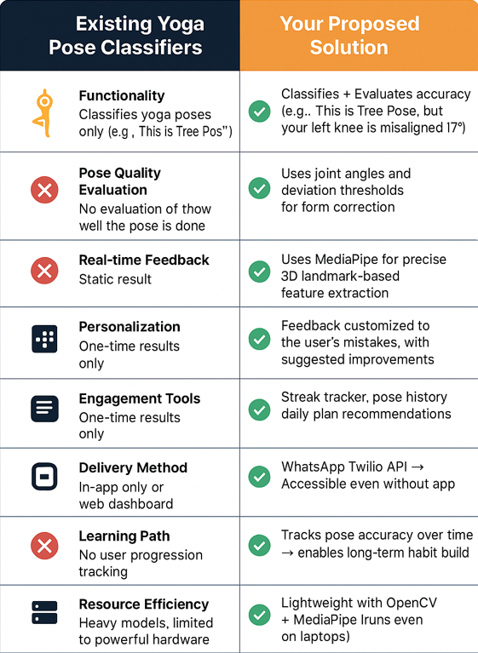
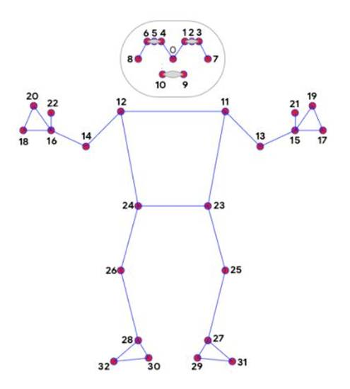
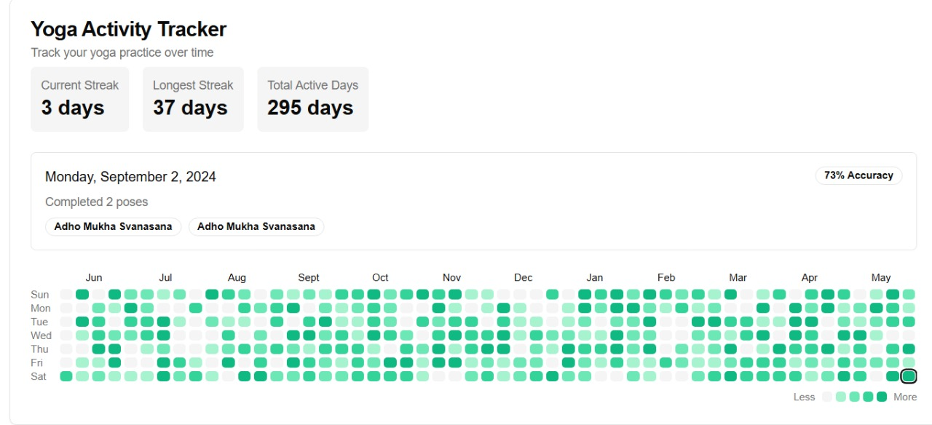












Powered by
Very scalable — because:
•MediaPipe runs on mobile and web
•Random Forest is lightweight
•It can be expanded to multi-person
detection with tracking
33 Body Land Marks

Slide 7
Powered by
Impact Area and Resources :
Future Goals :
Impact Area | How Your Solution Helps
Fitness and Wellness | Encourages proper form, reducing risk of injury
Remote Coaching | Makes posture correction available without a live coach
Education | Teaches users the correct anatomical structure of poses
Engagement | Gamifies yoga practice with streaks and recommendations
Inclusivity | Helps users in low-resource settings via WhatsApp
AI in Healthcare | Could evolve into posture correction for physio therapy
WhatsApp-First Wellness Ecosystem
AI Yoga Coach as a Service (YaaS)
Posture Score as a Wellness Metric
Buisness (Subscription based)
References :
BlazePose: On-device Real-time Body Pose tracking
https://arxiv.org/abs/2006.10204
Pose Detection Using OpenCV and MediaPipe
https://www.researchgate.net/publication/372257930_Real-Time_Yoga_Pose_Detection_Using_OpenCV_and_MediaPipe Implementation of Smart HealthCare System
https://www.researchgate.net/publication/322995546_Design_and_implementation_of_smart_HealthCare_system_using_IoT
Body Pose Tracking with MediaPipe BlazePose

Slide 8
THANK YOU
Lets move to the live demo !

